Slide 1






SPATIAL-TEMPORAL DEEP LEARNING MODEL FOR PREDICTING PARTICULATE MATTER 2.5 (PM2.5) IN SRI LANKAN URBAN CITIES
GROUP 10
17/06/2025

Slide 2



GROUP MEMBERS
Group 10
E/19/180 - Kapilan K.
E/19/202 - Kuganthan N.
E/19/397 - Thanujan I.
Supervised By: Dr. W.A.N.I. Harischandra
Dr. G.Bowatte

Slide 3

CONTENTS
01.Problem Introduction
02.Objectives
03.Literature Review
v
03.Literature Review
v
04.Methodology
v
05.Works up to Mid semester
04.Methodology
06.Statistical Test for CNN Architecture
v
07.Hybrid Model selection
v
08.Results
09.Conclusion

Slide 4
INTRODUCTION
Our research project focuses on predicting air pollution levels, specifically Particulate Matter 2.5 (PM2.5), in urban areas of Sri Lanka.
PM 2.5
Particles are defined by their diameter for air quality regulatory purposes.
Particles with a diameter less than or equal to 2.5 µm are classified as PM2.5.

Slide 5
The health effects due to PM2.5
Asthma
Lung cancer
Birth defects
Premature death
The factors affecting PM2.5
Vehicular emissions
Industrial activities
agricultural practices
weather conditions
natural sources like wildfires
Asthma

Slide 6
OBJECTIVE
To develop a predictive model using deep learning techniques to predict PM2.5 concentrations in Sri Lankan urban areas.
To extend our model's predictive capabilities to areas without sensor networks using satellite imagery and advanced deep learning techniques. This will enable the creation of air pollution maps that shows PM2.5 levels and trends across large geographic regions.
To develop a web-based database system.

Slide 7
LITERATURE REVIEW
Research Paper | Summary | Techniques Used
Amato, F.; Guignard, F.; Robert, S.; Kanevski, M. "A novel framework for spatio-temporal prediction of environmental data using deep learning." | This study introduces a deep learning framework for spatio-temporal prediction of environmental data, decomposing the signal into temporal basis functions (via EOFs) and stochastic spatial coefficients, which are modeled using a deep feedforward neural network | Empirical Orthogonal Functions (EOFs), Deep Feedforward Neural Network, Singular Value Decomposition (SVD),
Zhou, S.; Wang, W.; Zhu, L.; Qiao, Q.; Kang, Y. "Deep-learning architecture for PM₂.₅ concentration prediction: A review." | This review article provides a comprehensive analysis of deep learning (DL) architectures for predicting PM₂.₅ concentrations, focusing on model types and structures. | Long Short-Term Memory (LSTM) Networks, Hybrid Models,
H. Ahn, K. Sun and K. Pio Kim, "Comparison of missing data imputation methods in time series forecasting," | KNN method is very effective in reconstructing missing data values | k-nearest neighbors(KNN) method
Dewen Seng, Qiyan Zhang, Xuefeng Zhang, Guangsen Chen, Xiyuan Chen, Spatiotemporal prediction of air quality based on LSTM neural network | It can predict the concentration of multiple air quality indicators (PM2.5, CO, NO2, O3, SO2) simultaneously, instead of focusing on only one pollutant | MMSL, CNN-LSTM

Slide 8
Research Paper | Summary | Techniques Used
Shi, Y.; Du, Z.; Zhang, J.; Han, F.; Chen, F.; Wang, D.; Liu, M. "Construction and Evaluation of Hourly Average Indoor PM2.5 Concentration Prediction Models Based on Multiple Types of Places. | The paper presents the development and evaluation of hourly average indoor PM2.5 concentration prediction models using MLR (Multiple Linear Regression) and RFR (Random Forest Regression) methods based on monitoring data from diverse indoor environments. | Random Forest Regression, Multiple Linear Regression
Mei-Hsin Chen, Yao-Chung Chen, Tien-Yin Chou, Fang-Shii Ning, PM2.5 Concentration Prediction Model: A CNN–RF Ensemble Framework. | This study presents a hybrid CNN–RF framework that combines CNN for feature extraction with RF for regression to predict PM2.5 concentrations, compared with standalone CNN and RF models. | CNN, RF, CNN-RF model
Zheng, T.; Bergin, M. H.; Hu, S.; Miller, J.; Carlson, D. E. "Estimating ground-level PM₂.₅ using micro-satellite images by a convolutional neural network and random forest approach." | This study proposes a novel CNN-RF pipeline to estimate ground-level PM₂.₅ concentrations using high-resolution (3 m) PlanetScope satellite imagery. | CNN, RF, VGG16
Jiang, Z.; Zheng, T.; Bergin, M.; Carlson, D. "Improving spatial variation of ground-level PM₂.₅ prediction with contrastive learning from satellite imagery.” | This study introduces a Spatiotemporal Contrastive Learning (SCL) framework to enhance PM₂.₅ prediction at a high spatial resolution using satellite imagery. | Spatiotemporal Contrastive Learning (SCL), CNN

Slide 9
METHODOLOGY
Data Collection
Data Preprocessing and Preliminary Analysis
Develop a Web-based Database System
Temporal Model Development and Training
Model Evaluation
Temporal Model Evaluation
Combine Model Development and Training
Spatial Model Development and Training
Spatial Model Evaluation

Slide 10
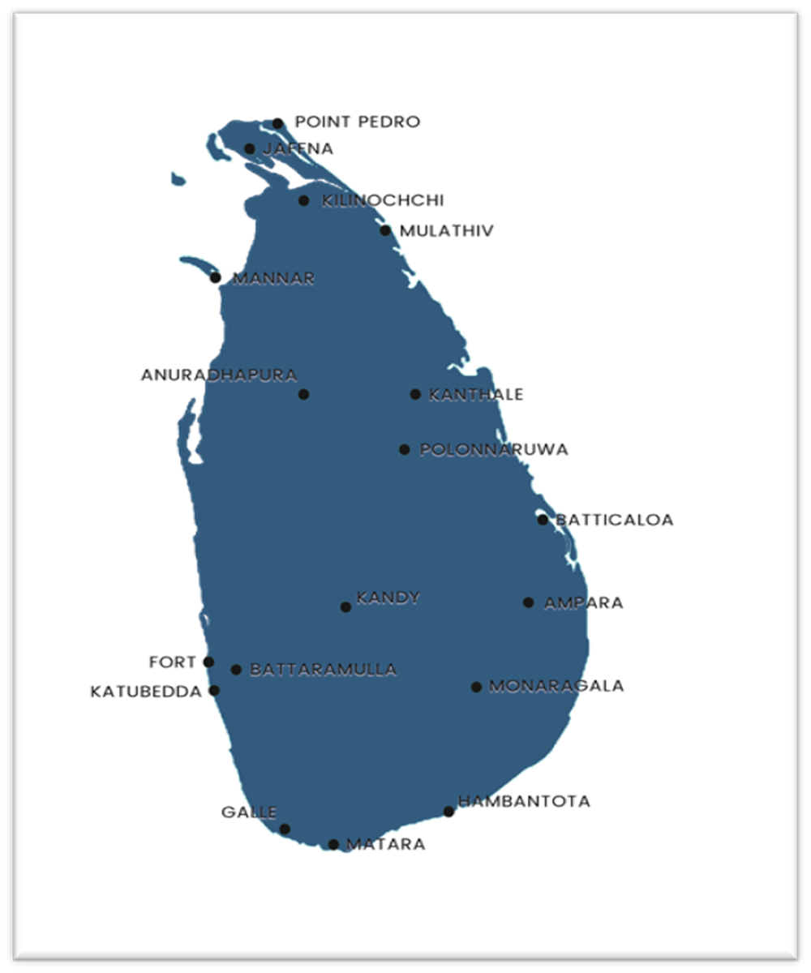
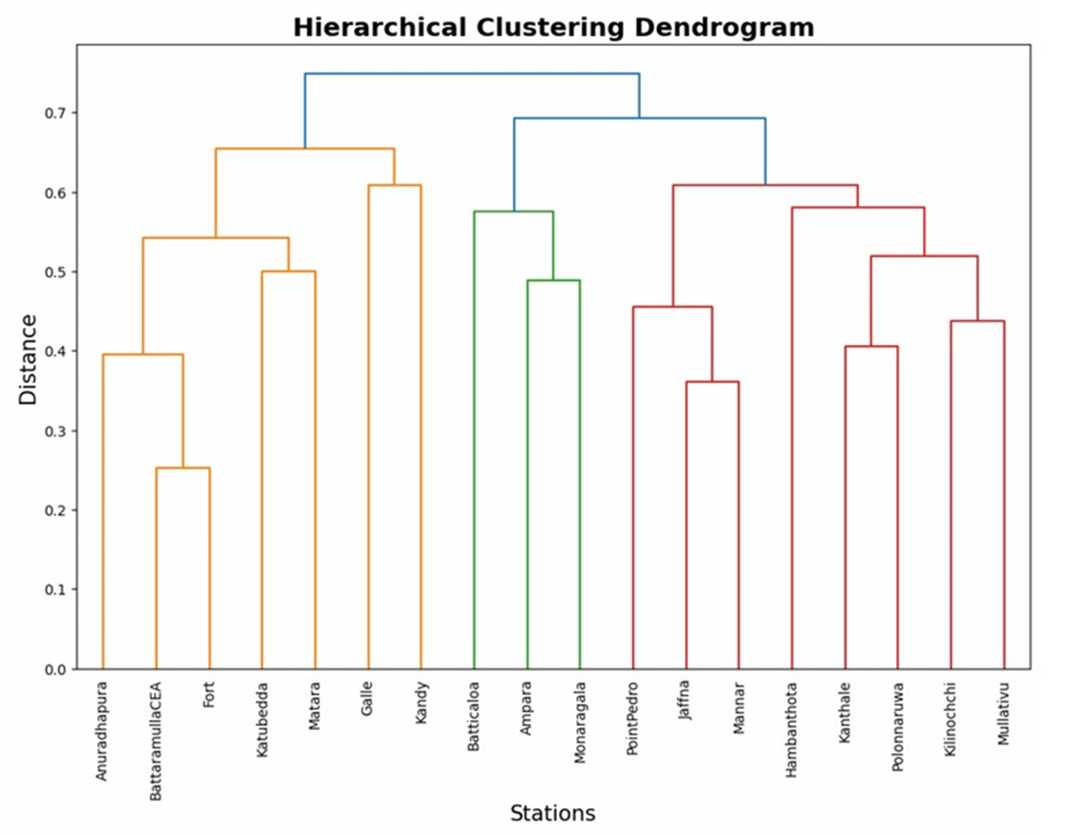
WORKS UP TO MID SEMESTER
Got temporal data from 18 air quality monitoring stations in Sri Lanka
Preprocess the data
Remove Outliers
Missing values Treatment
Clustered the stations
Selected and Developed models for temporal prediction
ARIMA
SARIMA
LSTM
GRU
BiLSTM
Evaluated the performance and compared the models

Slide 11
RESULTS COMPARISON
 | RMSE | MAE | R²
ARIMA | 5.044 | 3.607 | 0.011
SARIMA | 5.386 | 3.289 | 0.013
LSTM | 2.387 | 1.435 | 0.650
GRU | 2.795 | 1.682 | 0.639
BiLSTM | 4.903 | 3.016 | 0.542

Slide 12
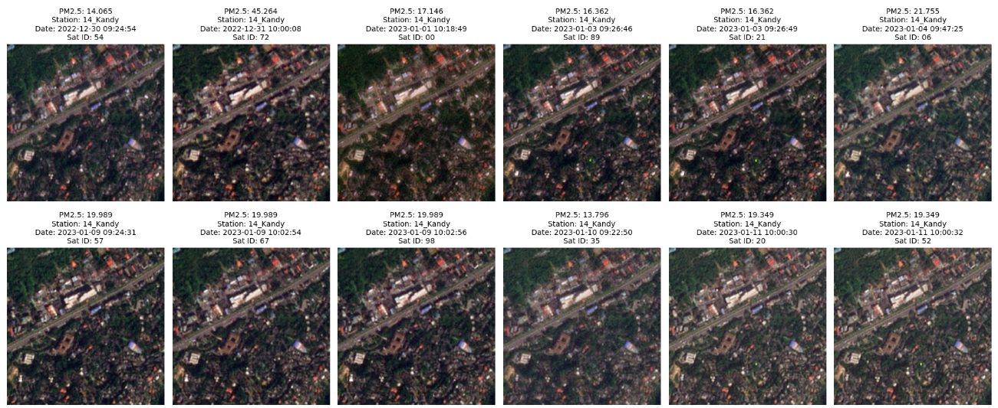
SPATIAL DATA COLLECTION
We got Spatial data consisting of satellite images, PM2.5 values, timestamps, dates, station numbers, and satellite indices was from 18 stations as a data cube.
Data was created from 1622 satellite images from all 18 station.

Slide 13
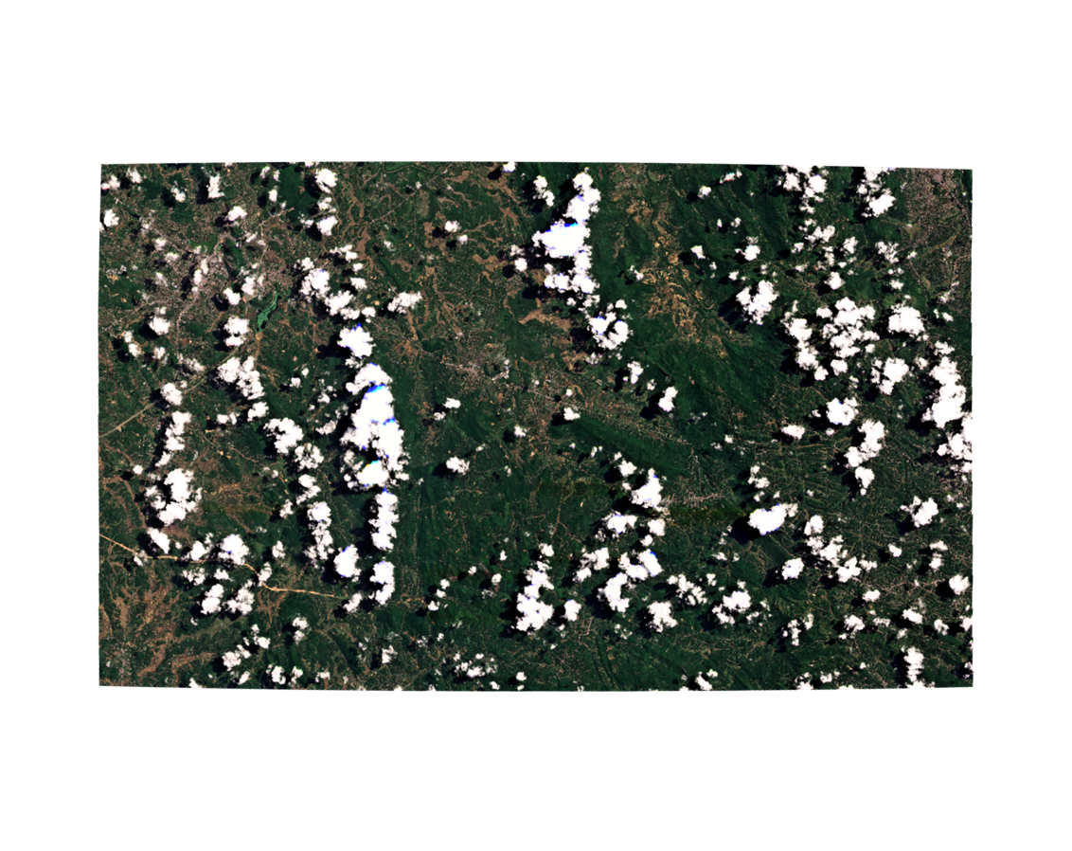
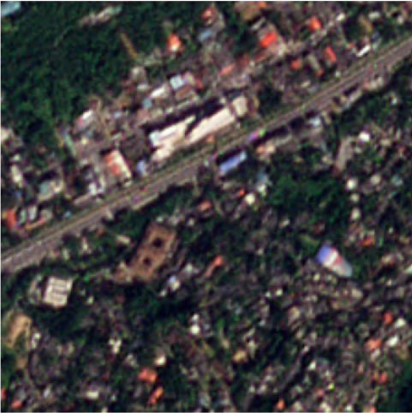
SPATIAL DATA PROCESS
Collected Satellite images were cropped into 224 × 224 pixels images with 3 color channels using latitude and longitude of the stations.
It was labeled with station ID and PM 2.5 value and saved as a data cube

Slide 14

MODEL SELECTION
For the spatial prediction, we selected CNN (Convolutional Neural Network)
Spatial Analysis
We select some architecture of CNN
VGG-16
LeNet-5
ResNet-50
MobileNet
Statistical
Deep Learning

Slide 15
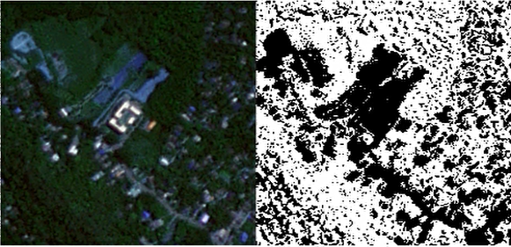
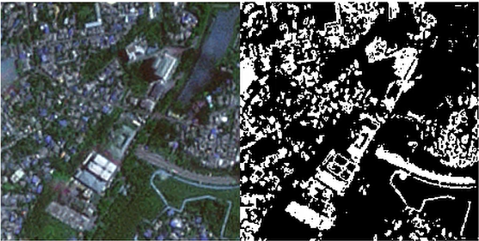
ADDING FEATURES
1.Green Index (NDVI)
High NDVI values indicate dense vegetation, which acts as a natural filter to reduce PM2.5 levels.
2.Urban Index (NDBI)
High NDBI values mark urban areas with elevated PM2.5 from human activities like traffic and industry.
Green Index
Urban Index

Slide 16
RESULTS COMPARISON
CNN - Architecture | RMSE |  | Coefficient of Determination
 | Mean | Variance | Mean | Variance
VGG – 16 (With feature) | 5.81 | 0.0589 | 0.631 | 0.00105
VGG – 16 (Without feature) | 6.16 | 0.0755 | 0.582 | 0.00163
LeNet - 5 (With feature) | 6.27 | 0.0187 | 0.573 | 0.000765
LeNet- 5 (Without feature) | 6.33 | 0.0526 | 0.565 | 0.00101
ResNet – 50 (With feature) | 7.35 | 0.0136 | 0.414 | 0.00035
ResNet – 50 (Without feature) | 7.39 | 0.0204 | 0.408 | 0.00053
MobileNet (With feature) | 6.65 | 0.0078 | 0.52 | 0.00016
MobileNet (Without feature) | 7.25 | 0.0202 | 0.429 | 0.0005

Slide 17
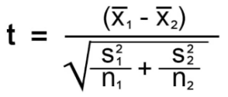
STATISTICAL TEST
Trained each model before and after adding features.
Repeated training 20 times per case.
Calculated mean and variance of RMSE and R² values
Performed statistical tests to compare performance across different models and to compare results before vs after adding features.
All models showed statistically different RMSE and R² values. However, the effect of adding features was not statistically significant for LeNet-5 and ResNet-50.

Slide 18
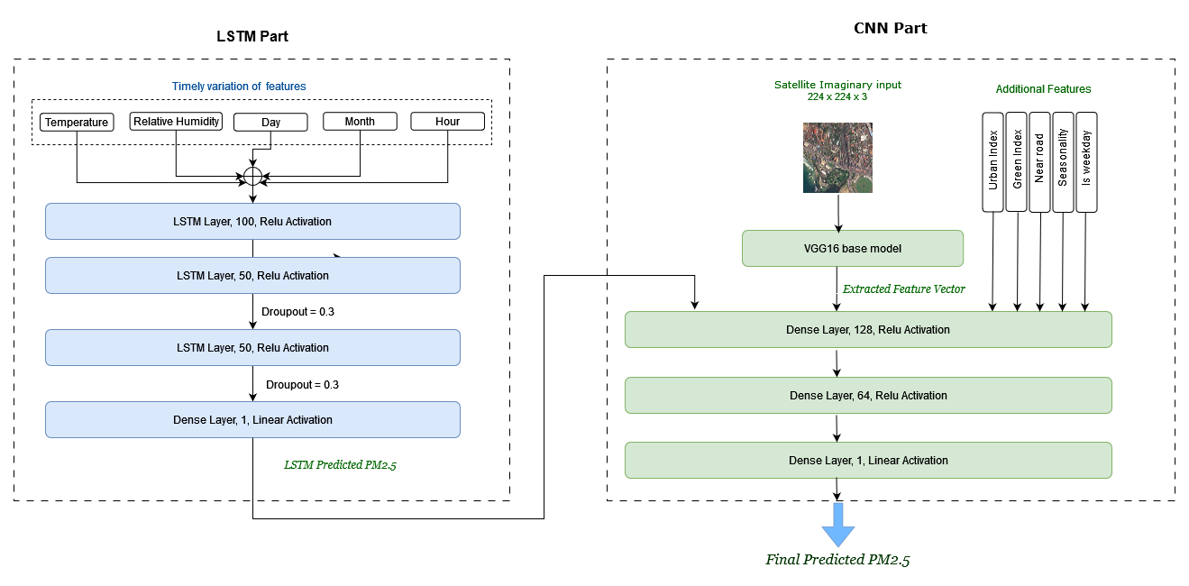
HYBRID MODEL DEVELOPMENT
LSTM Prediction as an Input
LSTM prediction as an input

Slide 19
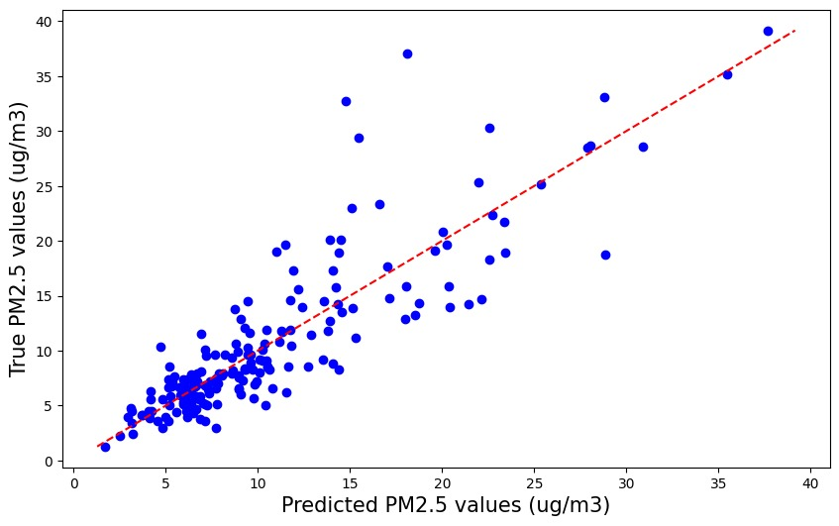
RESULT FROM HYBRID MODEL
Here we added the prediction came from LSTM to the CNN model as a input to improve the accuracy of the CNN model. That method gives better results compared to the previous ones as expected.
Mean Absolute Error: 2.3367
Root Mean Squared Error: 3.6096
Mean Absolute Percentage Error: 0.2373
Coefficient of determination: 0.7486
Scatter plot of actual vs predicted of Model

Slide 20
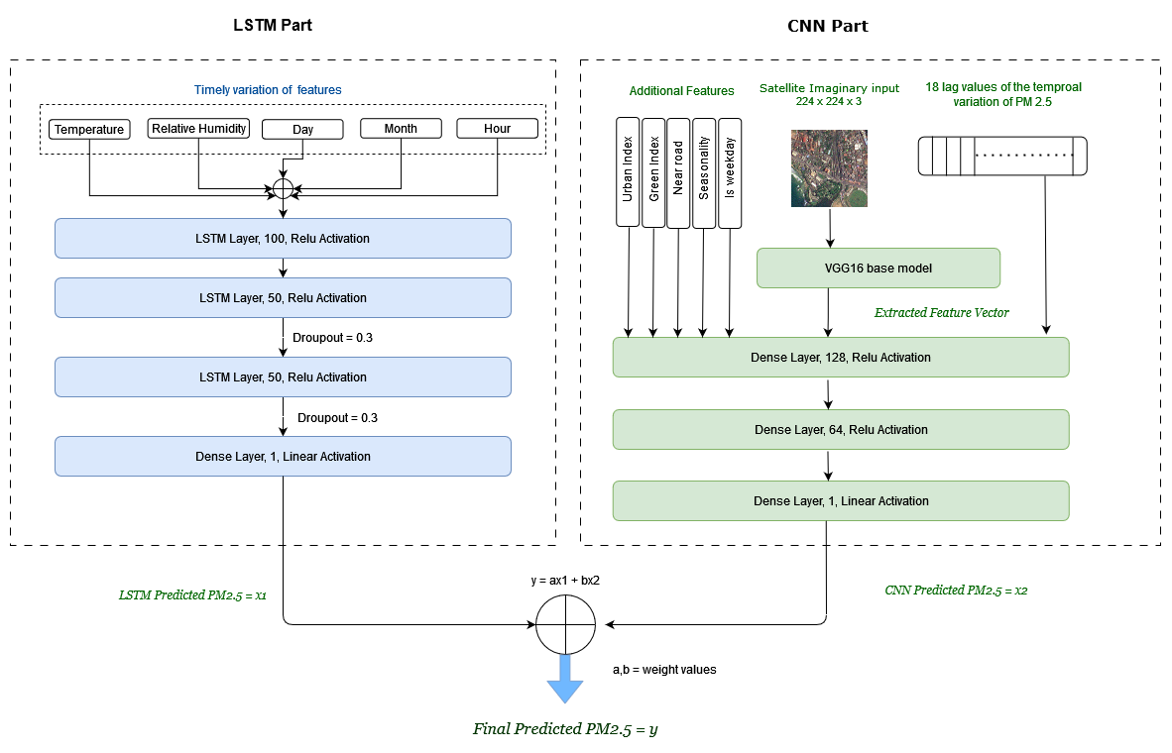
2. CNN and LSTM Prediction as an Input to Linear Regression
CNN and LSTM prediction as an input

Slide 21
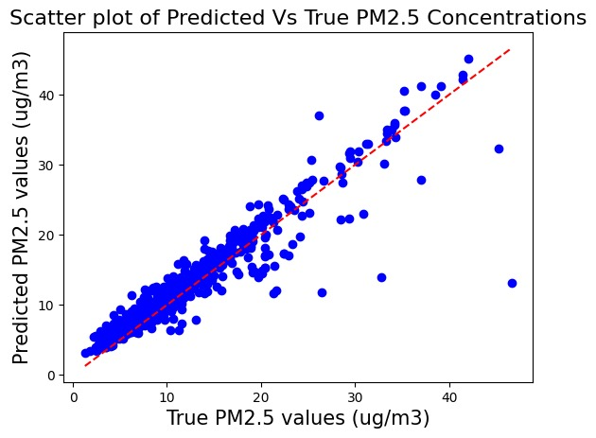
RESULT FROM HYBRID MODEL
Mean Absolute Error: 2.3367
Root Mean Squared Error: 3.6096
Mean Absolute Percentage Error: 0.2373
Coefficient of determination: 0.7486
Scatter plot of actual vs predicted of Model

Slide 22
RESULTS COMPARISON
 | LSTM | CNN | Hybrid CNN-LSTM Model
MAE | 2.958 | 1.818 | 1.520
RMSE | 6.215 | 2.893 | 2.377
MAPE | 0.495 | 0.190 | 0.149
R² | 41.13% | 69.84% | 86.86%

Slide 23
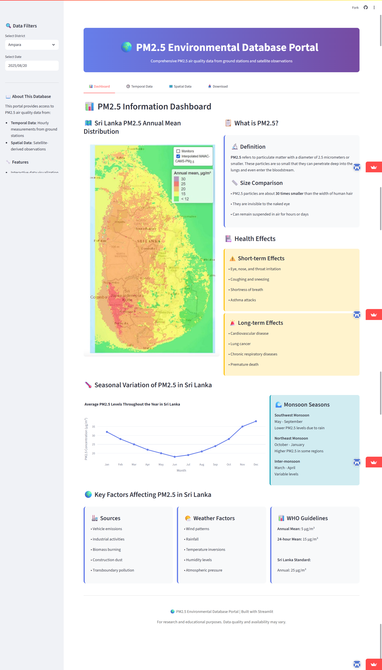
WEB BASED DATABASE SYSTEM
Link of the Page:
https://kapilan99-database-pm25-database-vghm2t.streamlit.app/

Slide 24
CONCLUSION
Each CNN model was trained 20 times and the mean and variance of RMSE and R² were computed, showing that model performance metrics differed significantly overall while adding the extra features did not produce a statistically significant effect for LeNet-5 or ResNet-50.
Among spatial CNNs, VGG - 16 augmented with NDVI and NDBI achieved the best spatial performance in the statistical test.
The hybrid pipeline that feeds LSTM temporal predictions into the CNN delivered the best overall results, demonstrating clear benefits from fusing temporal and spatial information.
We choose the hybrid approach using LSTM outputs and a VGG - 16 spatial backbone with NDVI and NDBI features

Slide 25
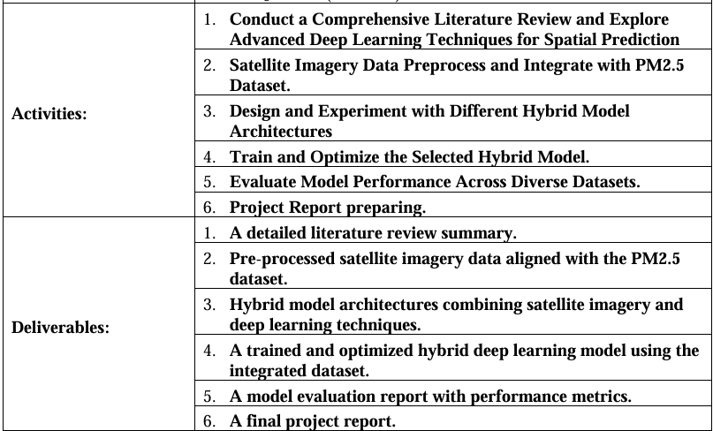
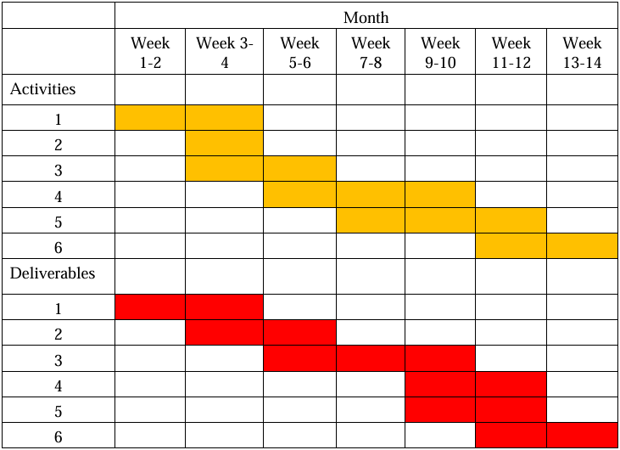
Project Deliverables and Gantt chart

Slide 26
REFERENCES
Shi, Y.; Du, Z.; Zhang, J.; Han, F.; Chen, F.; Wang, D.; Liu, M. Construction and Evaluation of Hourly Average Indoor PM2.5 Concentration Prediction Models Based on Multiple Types of Places. Frontiers in Public Health 2023, 11, 1213453. https://doi.org/10.3389/fpubh.2023.1213453D
Mei-Hsin Chen, Yao-Chung Chen, Tien-Yin Chou, Fang-Shii Ning, PM2.5 Concentration Prediction Model: A CNN–RF Ensemble Framework. International Journal of Environmental Research and Public Health 2023, 20, 4077. https://doi.org/10.3390/ijerph20054077
Zheng, T.; Bergin, M. H.; Hu, S.; Miller, J.; Carlson, D. E. "Estimating ground-level PM₂.₅ using micro-satellite images by a convolutional neural network and random forest approach." Atmospheric Environment 2020, 230, 117451. https://doi.org/10.1016/j.atmosenv.2020.117451
Amato, F.; Guignard, F.; Robert, S.; Kanevski, M. "A novel framework for spatio-temporal prediction of environmental data using deep learning." Scientific Reports 2020, 10, 22243. https://doi.org/10.1038/s41598-020-79148-7
H. Ahn, K. Sun and K. Pio Kim, "Comparison of missing data imputation methods in time series forecasting," Computers, Materials & Continua, vol. 70, no.1, pp. 767–779, 2022.
Dewen Seng, Qiyan Zhang, Xuefeng Zhang, Guangsen Chen, Xiyuan Chen, Spatiotemporal prediction of air quality based on LSTM neural network, Alexandria Engineering Journal, Volume 60, Issue 2, 2021,
Pages 2021-2032, ISSN 1110-0168.

Slide 27

THANK YOU

